Slide 1

CREDIT CARD FRAUD DETECTION
BRO-CODE
DATA ANALYTICS

Slide 2
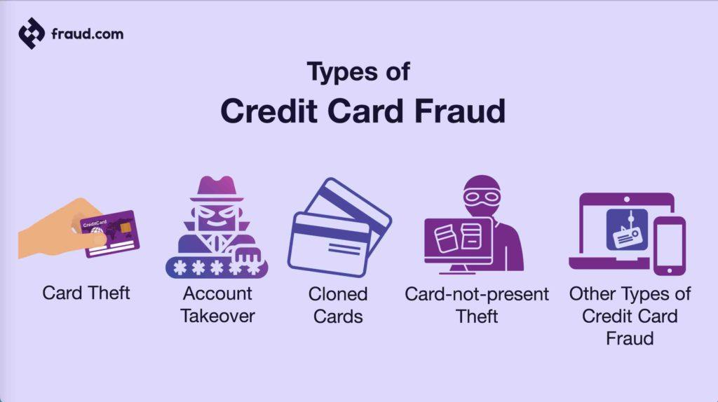
CREDIT CARD FRAUD DETECTION

Slide 3
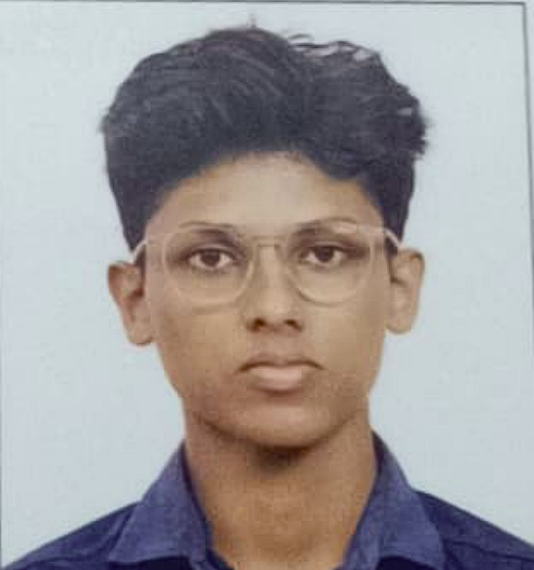
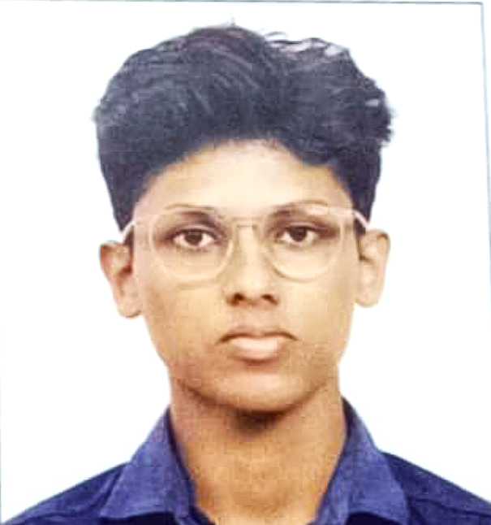
MEET OUR TEAM
Peter Ajith Cherian
Team Lead
AI/ML

Slide 4
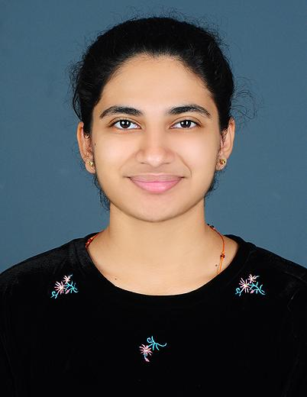



MEET OUR TEAM
Nibitha Glisson
Rohan Sony
Zayan Naazim
Chris Paul
DATA VISUALIZATION
DATA ANALYSIS
AI /ML
DATA CLEANING

Slide 5



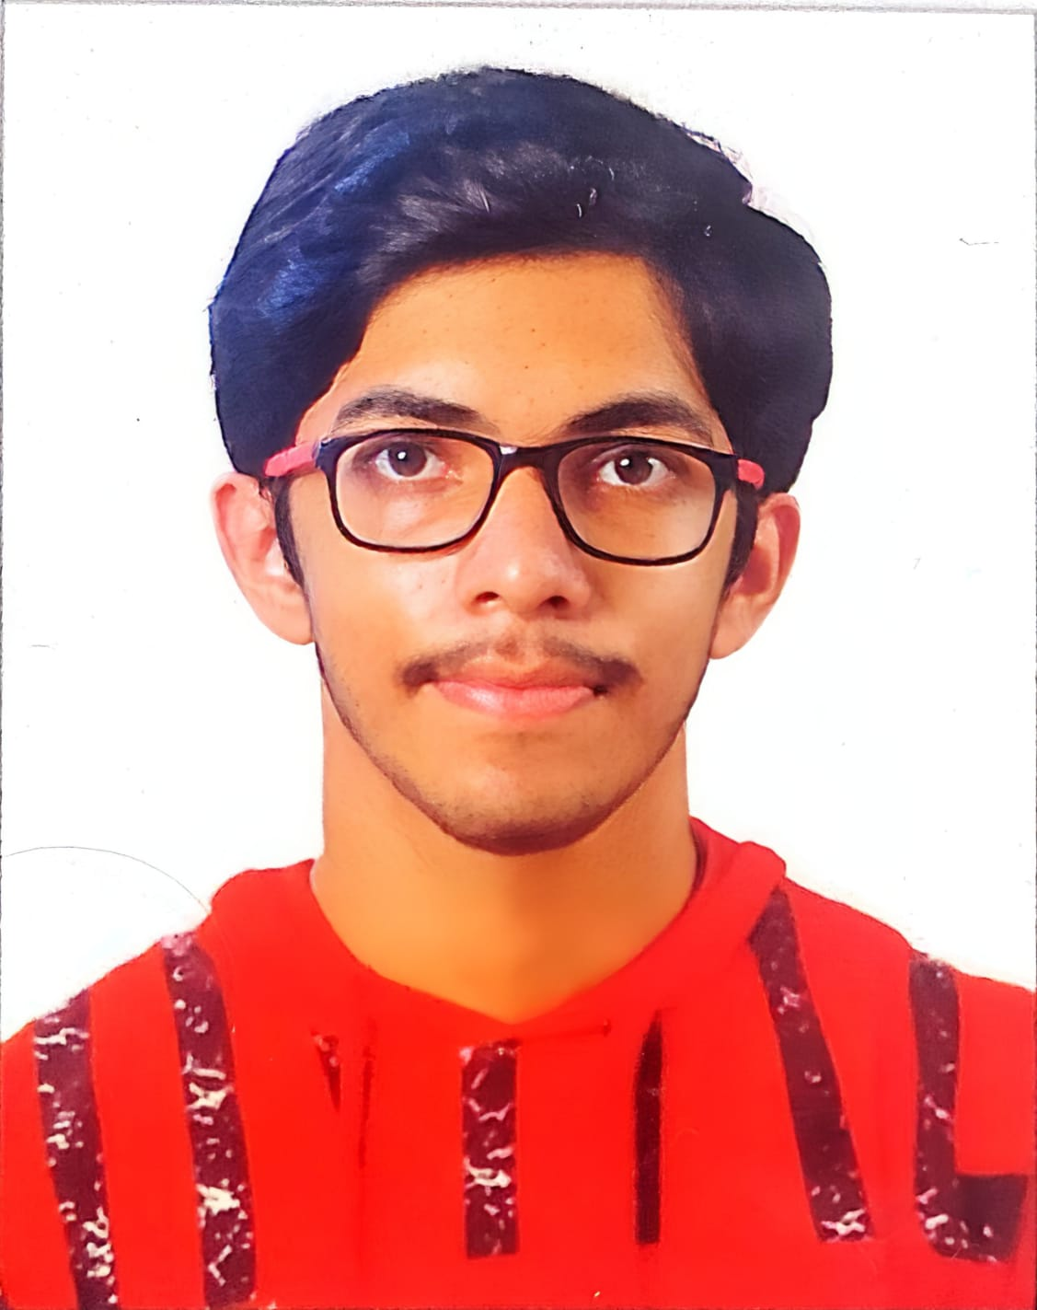
MEET OUR TEAM
Vignesh Vijayan
Aadil Aafil
Jiyaro Joseph
Kevin Vinod
DATA VISUALIZATION
DATA VISUALIZATION
DATA ANALYSIS
DATA CLEANING

Slide 6
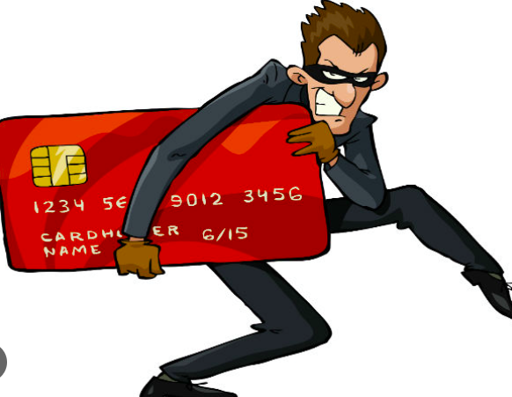
INTRODUCTION
Understanding the Problem
Credit card fraud is a significant challenge for financial institutions. It involves unauthorized use of credit card information to make fraudulent transactions. Data analytics plays a crucial role in detecting and preventing such fraudulent activities.
Project Objective
The primary goal of this project is to develop a robust model capable of identifying fraudulent credit card transactions accurately. By analyzing historical transaction data, we aim to uncover patterns and anomalies associated with fraudulent activities. This knowledge can be utilized to build a predictive model that can flag suspicious transactions in real-time.

Slide 7
IMPORTANCE OF PROJECT
Credit card fraud is a significant challenge for financial institutions. It involves unauthorized use of credit card information to make fraudulent transactions. Data analytics plays a crucial role in detecting and preventing such fraudulent activities.
Financial Loss Prevention: Fraudulent charges can lead to significant financial losses for consumers.
Identity Theft: Credit card fraud is often a precursor to identity theft, exposing individuals to further risks.
In essence, credit card fraud detection is vital for protecting individuals, businesses, and the overall economy. As technology evolves and fraudsters become more sophisticated, the need for robust fraud prevention measures will only increase.

Slide 8
PROJECT SUMMARY
Data Acquisition and Exploration
The project will commence with acquiring a suitable dataset containing credit card transaction records. This dataset should encompass a diverse range of transactions, including both legitimate and fraudulent ones. Once the data is collected, a thorough exploratory data analysis (EDA) will be conducted to understand its characteristics, identify missing values, outliers, and potential correlations between variables.
Data Preprocessing/Cleaning
The collected data often requires preprocessing to prepare it for analysis. This step involves handling missing values, outliers, and inconsistencies in the data. Feature engineering may also be necessary to create new variables that could be relevant for fraud detection.

Slide 9
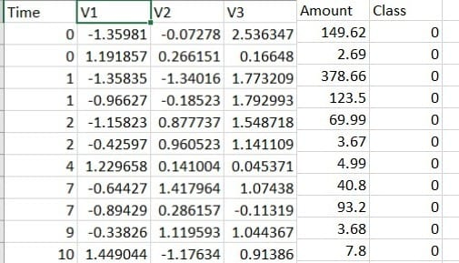
SOURCES OF DATA USED
The dataset for our credit card fraud detection project is sourced from Kaggle. This dataset is rich with various features that enable us to analyze, visualize and predict fraudulent credit card transactions.
V1, V2, ..., V28: These are the 28 principal components resulting from the PCA transformation of the original features.
Time: The seconds elapsed between each transaction and the first transaction in the dataset.
Amount: The transaction amount.
Class: ‘1’ indicates fraud and ‘0’ indicates not fraud.
Dataset for Credit Card Fraud Detection: https://www.kaggle.com/datasets/mlg-ulb/creditcardfraud

Slide 10





DATA MODULES USED
Mathemat-ical functions library in python.
Library based on matpilot in python
Library for manipulation of data
And easy to use structures
It is a machine learning library for functions like regression,red-uction

Slide 11
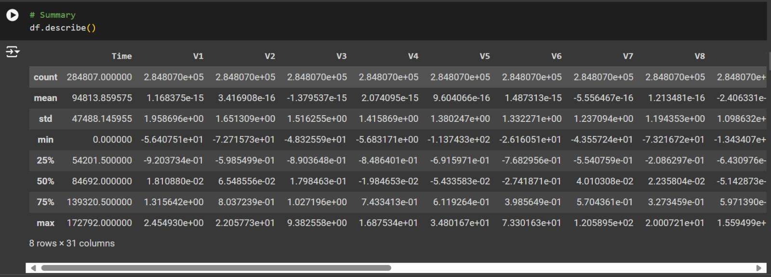
DATA BEFORE CLEANING

Slide 12
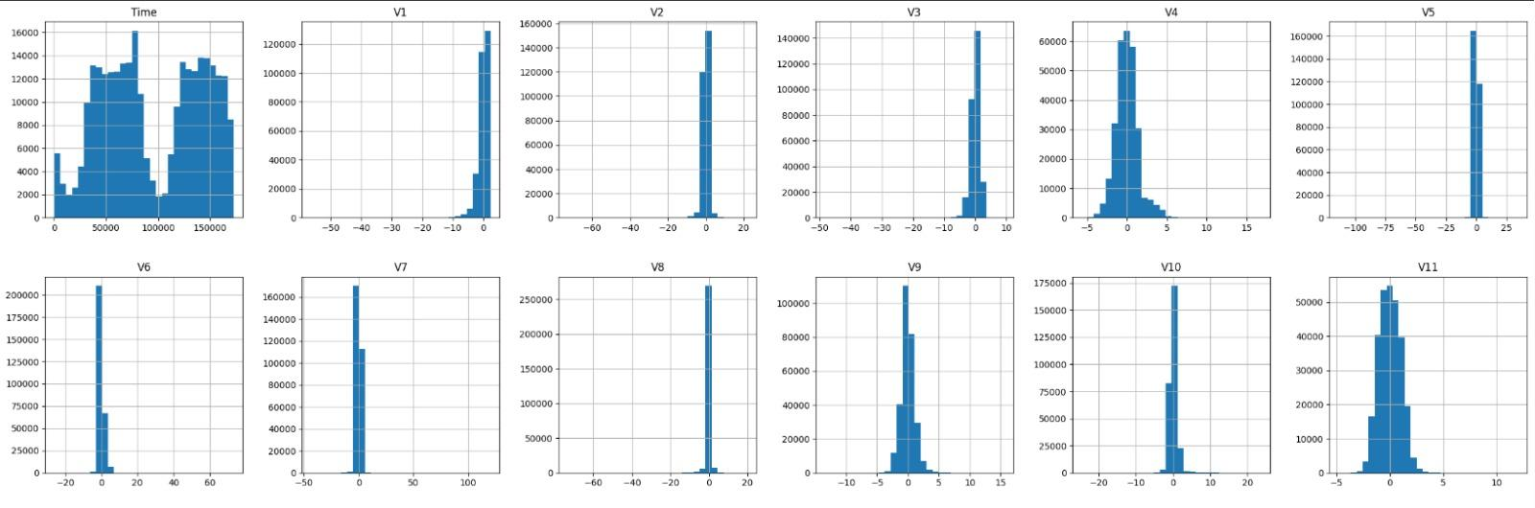
GRAPH BEFORE CLEANING

Slide 13
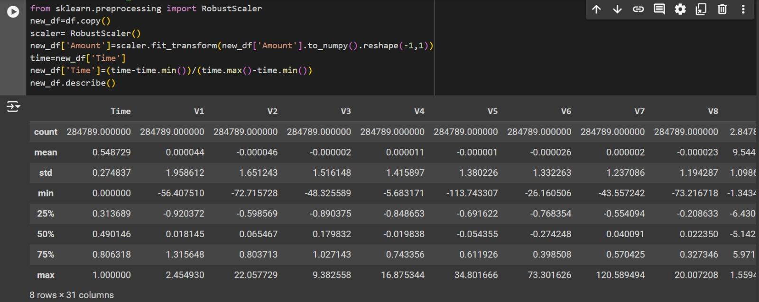
DATA AFTER CLEANING

Slide 14
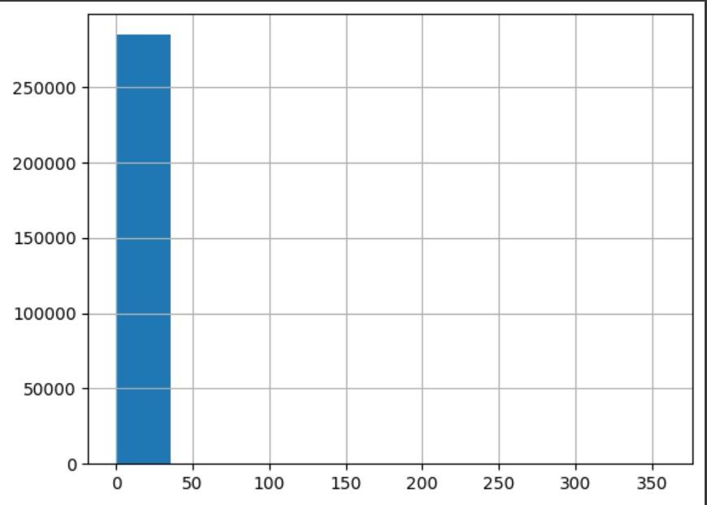
GRAPH AFTER CLEANING DATA

Slide 15
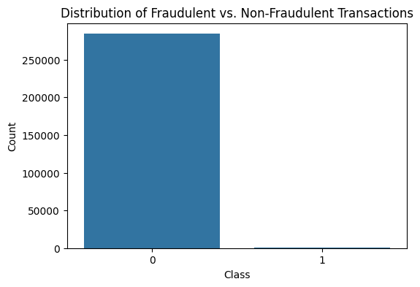
VISUALIZATION OF DATA
There is a substantial class imbalance in the dataset, with non-fraudulent transactions vastly outnumbering fraudulent ones. This imbalance is common in fraud detection datasets and poses a challenge for machine learning models, which may become biased towards predicting the majority class (non-fraudulent transactions).

Slide 16
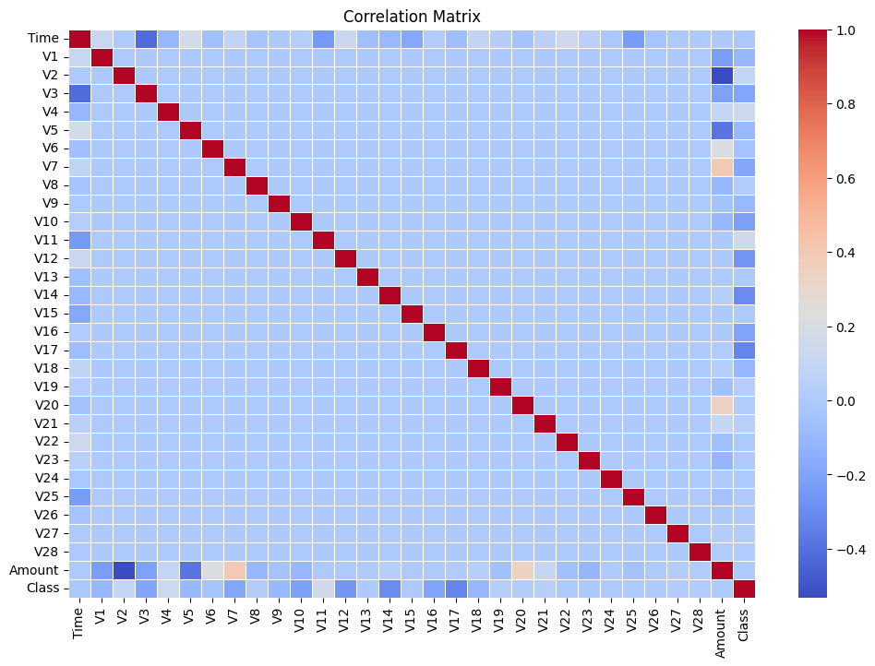
Features with higher correlations (positive or negative) with the target variable 'Class' can be considered important for building predictive models. In this case, V4, V11, V12, V14, and V17 are noteworthy

Slide 17
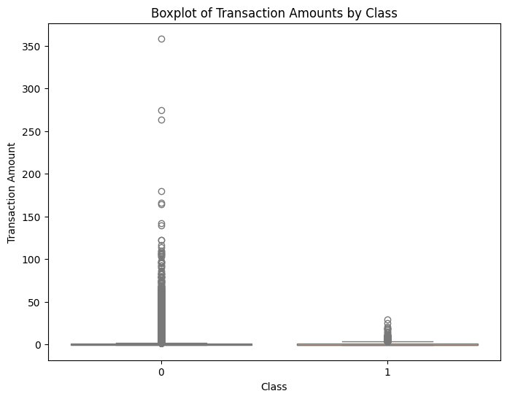
Non-fraudulent transactions tend to have higher variability and more high-value transactions compared to fraudulent transactions.
Fraudulent transactions generally involve smaller amounts, which might be a strategy to avoid detection.

Slide 18
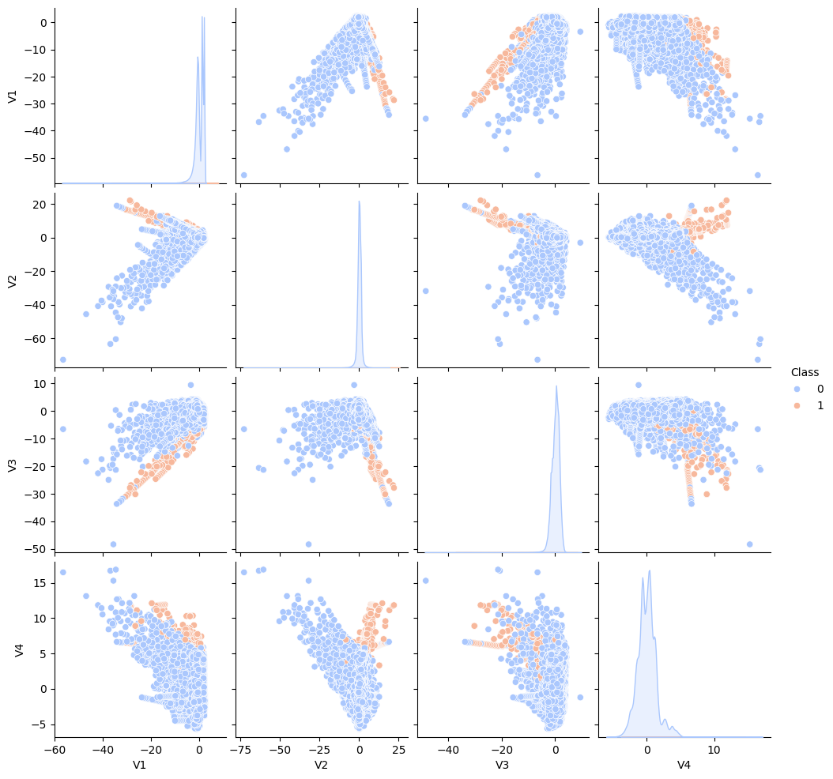
The histograms along the diagonal show the distribution of individual variables for both classes. This type of visualization is useful for identifying correlations, clusters, or patterns in multivariate data.

Slide 19
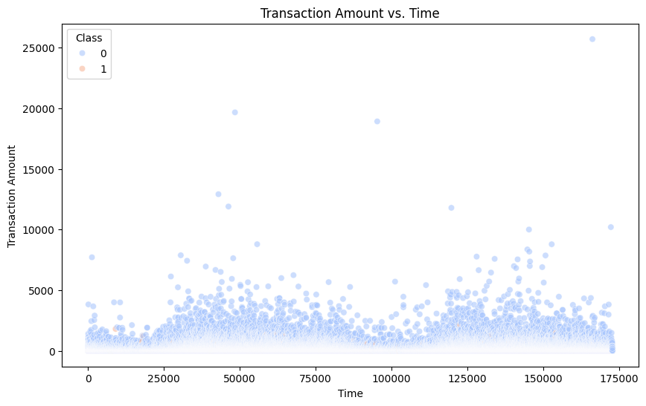
the graph provides a preliminary overview of transaction amounts over time

Slide 20
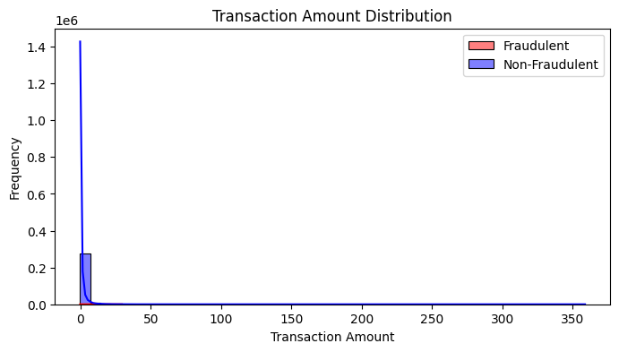
the graph provides a preliminary understanding of the distribution of transaction amounts for fraudulent and non-fraudulent cases

Slide 21
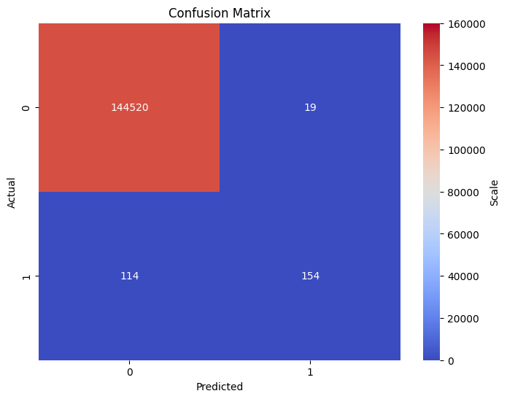
Machine Learning Model - Logistic Regression
Training Accuracy: 99.91%
Testing Accuracy: 99.09%
Precision: 0.89
Recall: 0.57
F1 Score: 0.70
ROC-AUC Score: 0.98
Confusion Matrix:
True Positives (TP): 154
True Negatives (TN): 144520
False Positives (FP): 19
False Negatives (FN): 114

Slide 22
Credit Card Fraud Detection API
A web service that predicts whether a given credit card transaction is fraudulent or not.
Built using Flask, a lightweight Python web framework.
Employs a pre-trained machine learning model for predictions.
Flask Application:
Defines an endpoint (/) that accepts transaction data and returns a prediction.
Machine Learning Model:
Pre-trained to identify fraudulent transactions.
Saved in a file and loaded into the Flask application

Slide 23
API Endpoint and Deployment
API Endpoint:
/ Endpoint:
Accepts POST requests with JSON payloads containing transaction features.
Returns a prediction as a JSON response indicating if the transaction is fraudulent.
Process Flow:
Request: Client sends a POST request to the API with transaction data in JSON format.
Data Processing: Flask application extracts and formats transaction features.
Prediction: Model processes features and predicts if the transaction is fraudulent.
Response: Application returns the prediction result in JSON format.

Slide 24
Code Example to Access the API (PowerShell)
$body = @{
features = @(133184,-1.212681701,-2.48482353,-6.397185815,3.670562448,-0.863375061,-1.855854731,1.01773158,-0.544703775,-1.70337805,-3.739659479,1.738124014,-2.844449336,0.765863961,-4.799737135,-0.011335412,-2.693168082,-3.166955158,-1.06780012,-0.559132202,2.908373946,1.396872063,0.092072872,-1.492882499,-0.204227396,0.532510949,-0.293871104,0.21266306,0.431094708,1335)
} | ConvertTo-Json
$headers = @{
"Content-Type" = "application/json"
}
$response = Invoke-RestMethod -Uri "https://fraud-detection-3vxr.onrender.com" -Method Post -Headers $headers -Body $body
$response

Slide 25

CONCLUSION
In essence credit card fraud is one of the most discussed field in today’s world and it is a crime that is happening daily.
So with this project we have analyzed , cleansed and trained and AI model in form of an API to help to solve the problem.
With the help of Python our team has found the best way to resolve credit card fraud
And implemented as an API.

